Slide 1
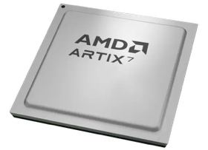
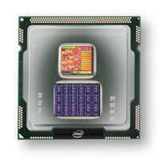
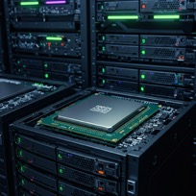
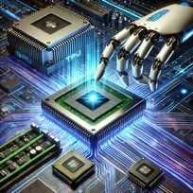
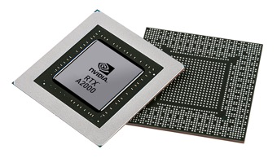


Christof Teuscher
ECE 410/510: Hardware for AI and ML
Spiking transformer + In-memory computing
Portland State University
Department of Electrical and Computer Engineering (ECE)
www.teuscher-lab.com
teuscher@pdx.edu

Slide 2
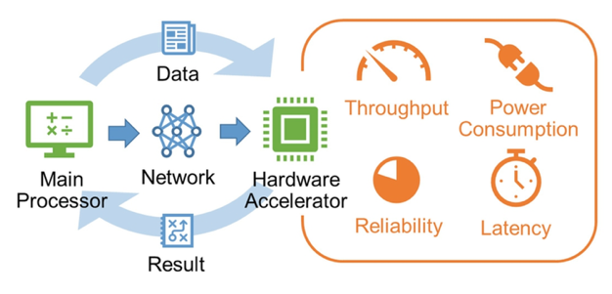
How can we accelerate an algorithm?
Or in other words: solve a problem as fast as possible?

Slide 3
How can we accelerate an algorithm?
Technology scaling (but Moore’s law is flattening out)
Cache optimizations
Code optimization
Exploiting parallelism
GPUs
TPUs
Fancier CPUs? More pipelining? Faster storage? Better networking?
HW/SW co-design
Improve the algorithm (trade time for space, approximations, etc.)
Emerging technology

Slide 4
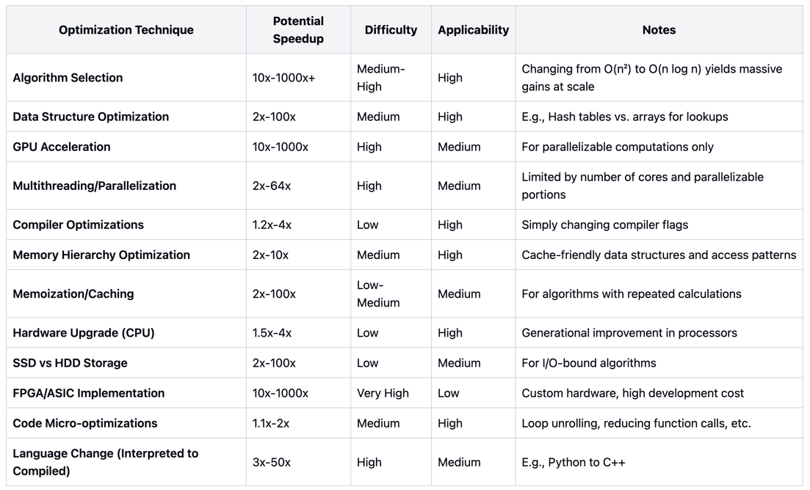
Traditional technology

Slide 5
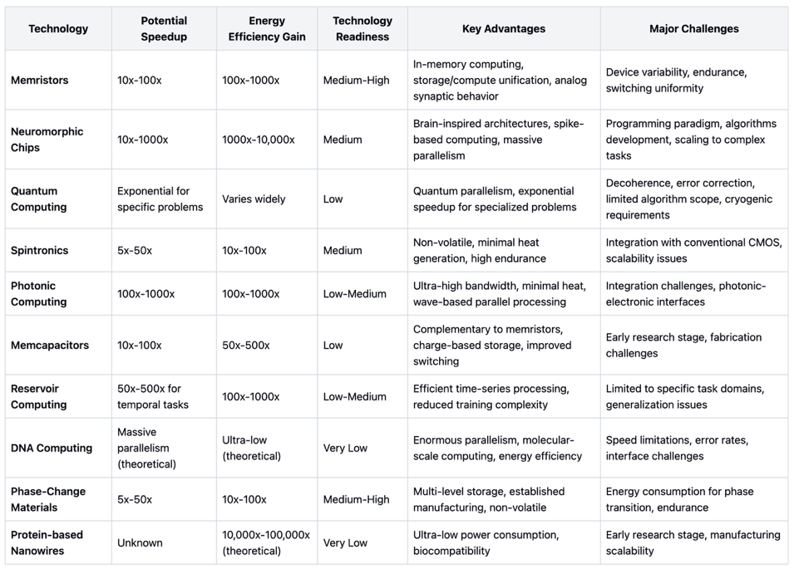
Emerging technology

Slide 6
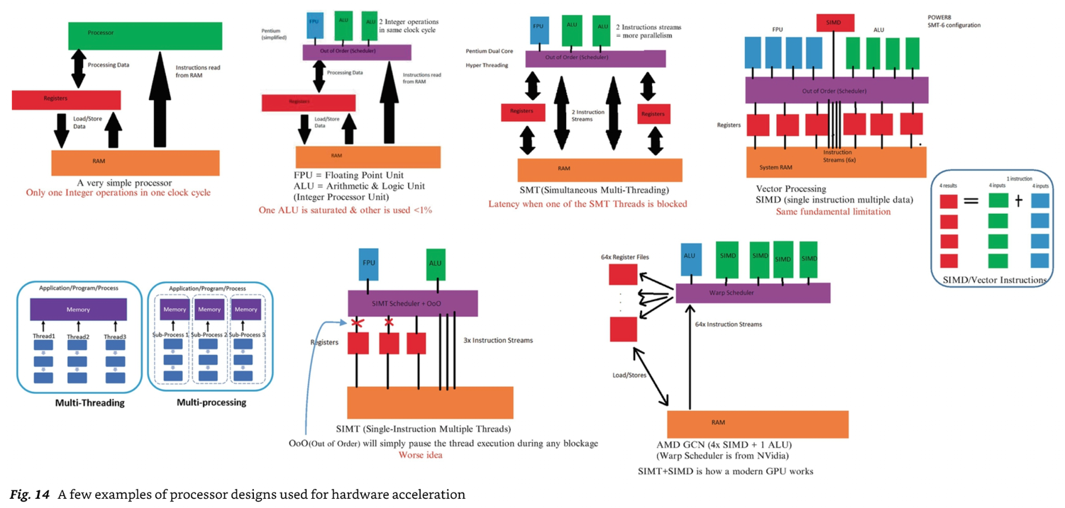
Mishra et al.

Slide 7
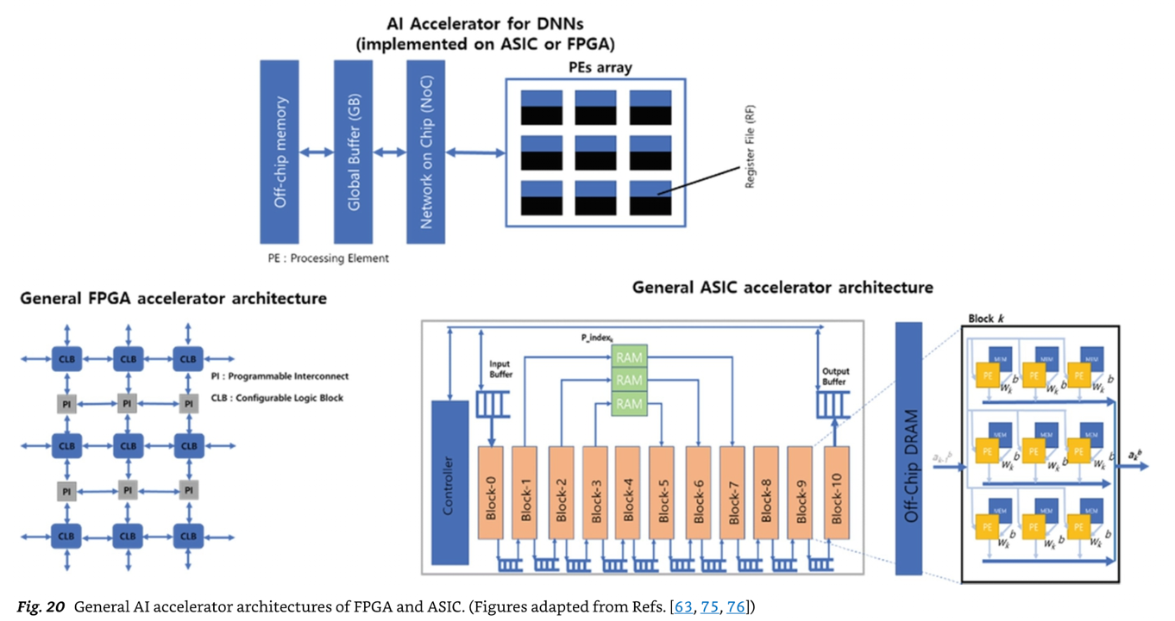
No Free Lunch theorem (NFL)
Mishra et al.

Slide 8
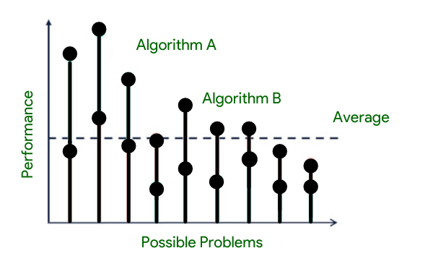
No Free Lunch theorem (NFL)
The "No Free Lunch" (NFL) theorem in optimization and machine learning states that, when averaged across all possible problems, all optimization algorithms perform equally well. I.e., no algorithm consistently outperforms random search or any other algorithm.
The NFL theorem was formalized by David Wolpert and William Macready in 1997.
This principle has profound implications for ML and HW optimization:
It explains why specialized algorithms/architectures work well for specific domains but fail in others.
It highlights the importance of incorporating domain knowledge when selecting algorithms/architectures.
It reminds us that claims about algorithm/architecture superiority must specify the context/problem class.
https://www.geeksforgeeks.org/what-is-no-free-lunch-theorem
https://ieeexplore.ieee.org/document/585893

Slide 9
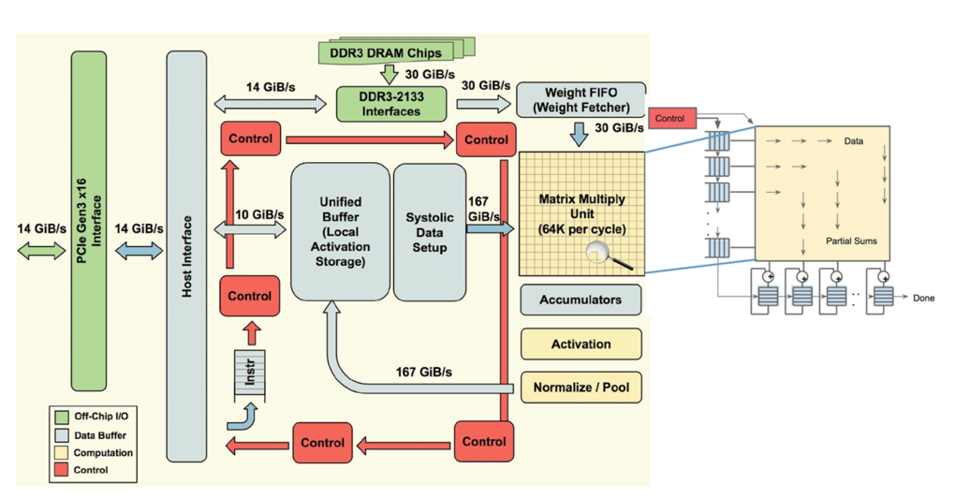
Architecture of a TPU accelerator
The main component of TPU is the MXU that consists of 256 by 256 (i.e., 65,536) MACs to perform 8-bit mathematical operations.
The MXU gets its input from the weighted FIFO and unified buffer (UB).
https://cloud.google.com/blog/products/ai-machine-learning/an-in-depth-look-at-googles-first-tensor-processing-unit-tpu

Slide 10
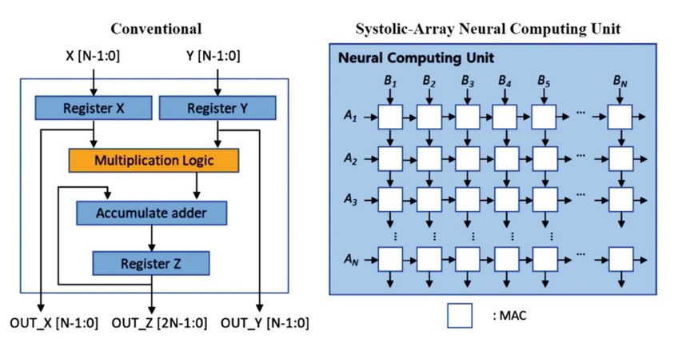
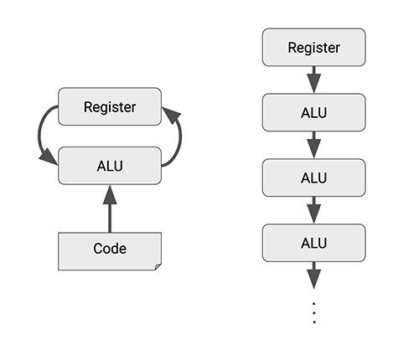
Systolic array
The name "systolic" comes from an analogy to the human heart, where data pulses through the array of processors in a rhythmic, synchronized fashion.
CPUs and GPUs often spend energy to access multiple registers per operation. A systolic array chains multiple ALUs together, reusing the result of reading a single register.
Mishra et al., 2023

Slide 11
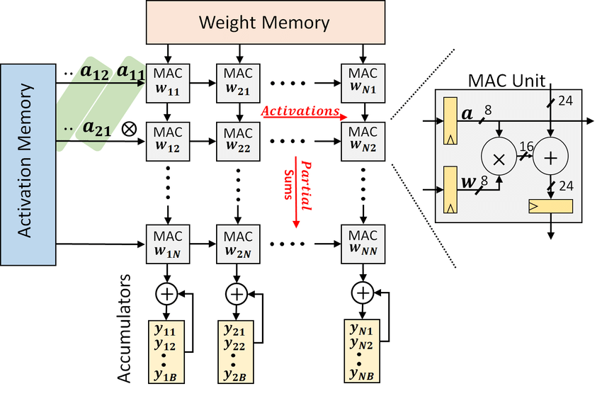
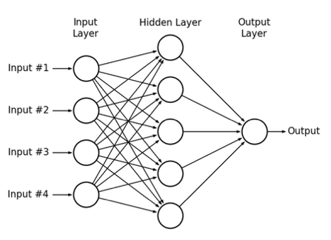
How to map a deep neural net on a systolic array
https://doi.org/10.1145/3195970.3196129

Slide 12
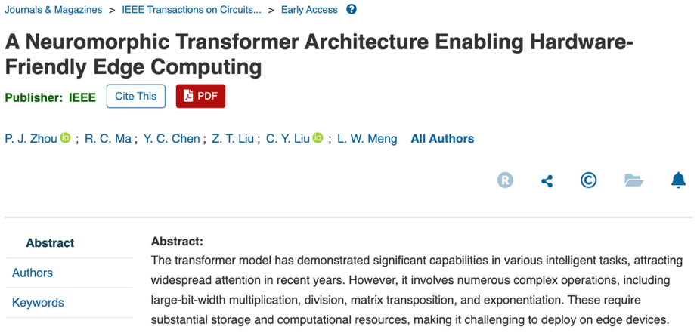
https://ieeexplore.ieee.org/abstract/document/10962199

Slide 13
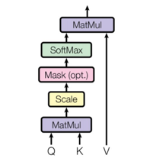
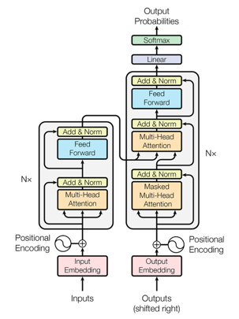
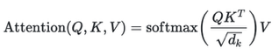
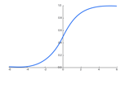
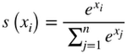
What transformer operations could we improve?
Matrix Multiplication - Used throughout the architecture, particularly in the attention mechanism and feed-forward networks.
Attention Mechanism - The core operation involving:
Query, Key, Value transformations (matrix multiplications)
Scaled dot-product attention:
Multi-head attention which runs multiple attention operations in parallel
Layer Normalization - Normalizes the outputs of sub-layers using mean and variance statistics
Residual Connections (Skip Connections) - Addition operations that help with gradient flow
Position-wise Feed-Forward Networks - Two linear transformations with a ReLU activation in between
Softmax - Used in the attention mechanism to convert scores to probabilities
Positional Encoding - Often implemented using sine and cosine functions of different frequencies
Embedding - Converting tokens to continuous vector representations
Query Key Value

Slide 14
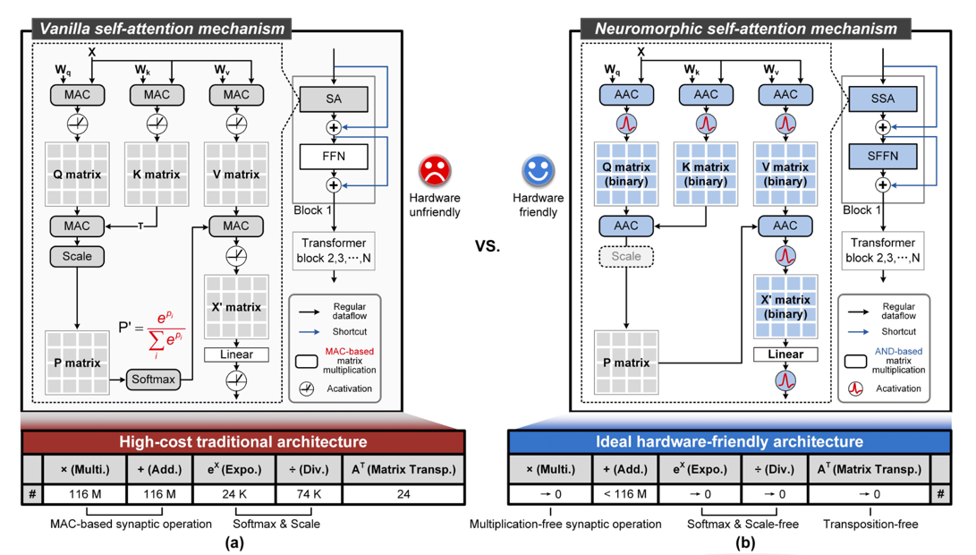
Neuromorphic self-attention mechanism
https://ieeexplore.ieee.org/abstract/document/10962199

Slide 15
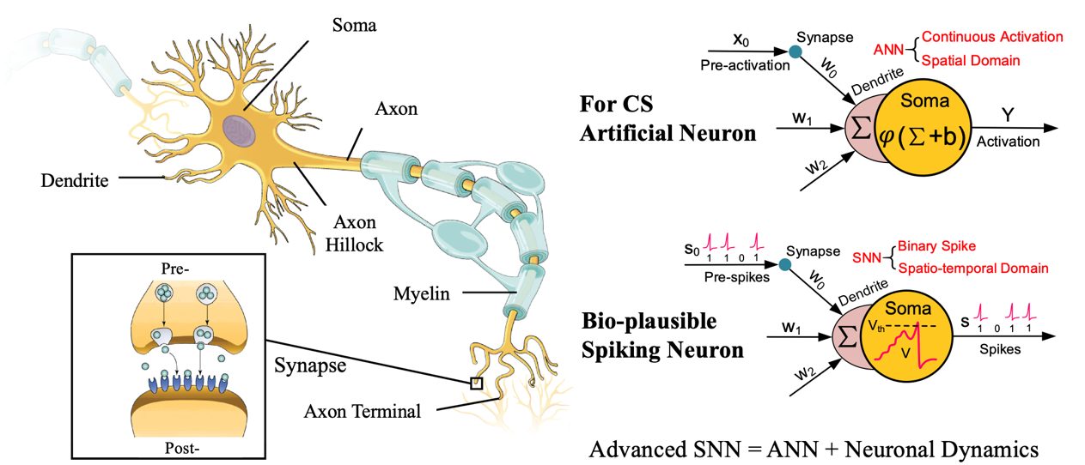
To spike or not to spike (1)

Slide 16
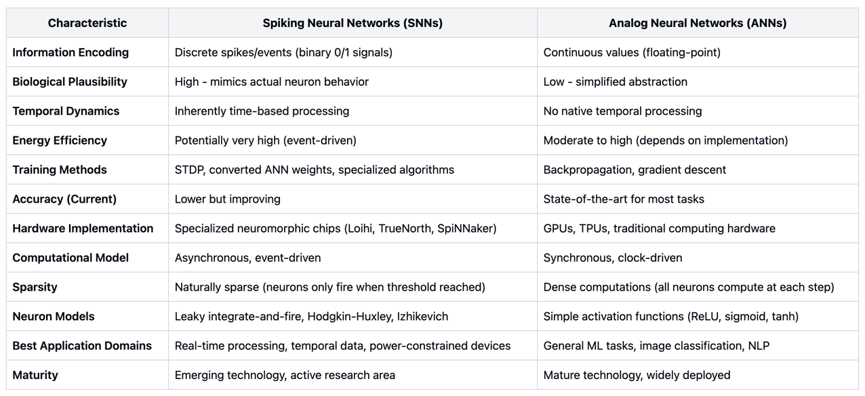
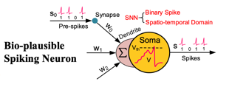
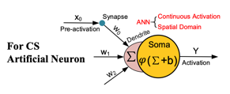
To spike or not to spike (2)

Slide 17
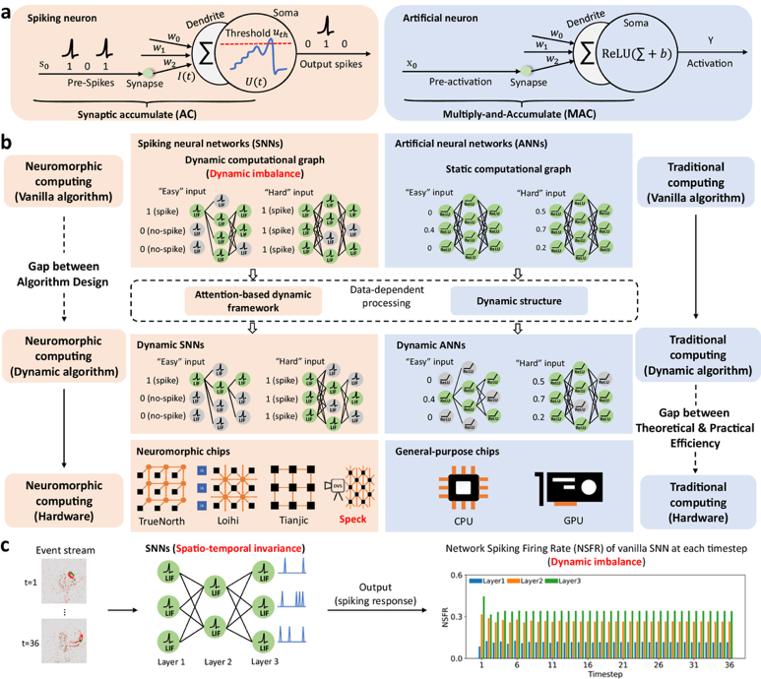
https://www.nature.com/articles/s41467-024-47811-6

Slide 18
Neuromorphic self-attention mechanism
AAC =
AND accumulate
Why is that equivalent to MAC?
https://ieeexplore.ieee.org/abstract/document/10962199

Slide 19
AND accumulate
Traditional:
output = (input1 × weight1) + (input2 × weight2) + ... + (inputN × weightN)
AND accumulate:
output = (input1 AND weight1) + (input2 AND weight2) + ... + (inputN AND weightN)
This process essentially counts how many input-weight pairs are both "on" (1) at the same time, which serves as an approximation of multiplication in binary or highly quantized networks.
Binary multiplication = AND operation

Slide 20
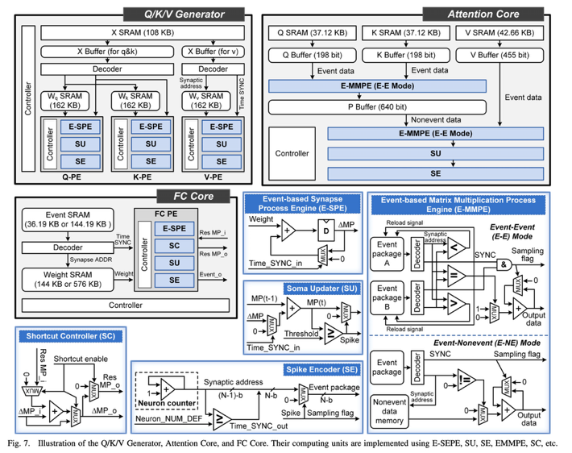
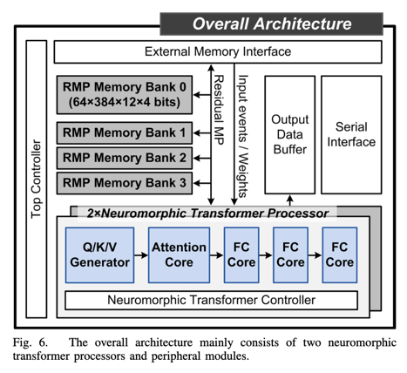
Architecture
https://ieeexplore.ieee.org/abstract/document/10962199

Slide 21
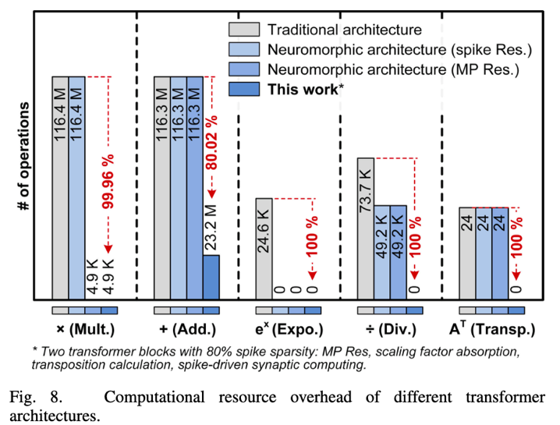
Resource overhead
Res. = Residuals
MP = membrane potential
https://ieeexplore.ieee.org/abstract/document/10962199

Slide 22
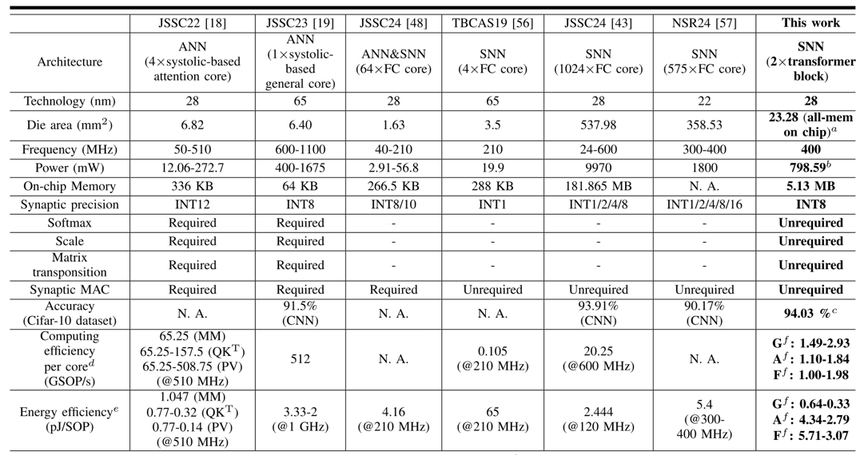
Comparison with state-of-the-art
SOP = Standard Operations Per Second
GSOP/s = Giga Standard Operations Per Second
Different cores of their design
https://ieeexplore.ieee.org/abstract/document/10962199

Slide 23
What are the biggest bottlenecks in traditional
computer architecture?

Slide 24
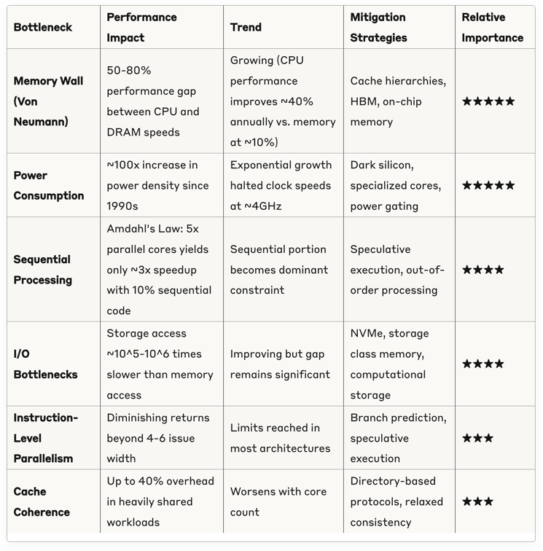
Impact of major bottlenecks

Slide 25
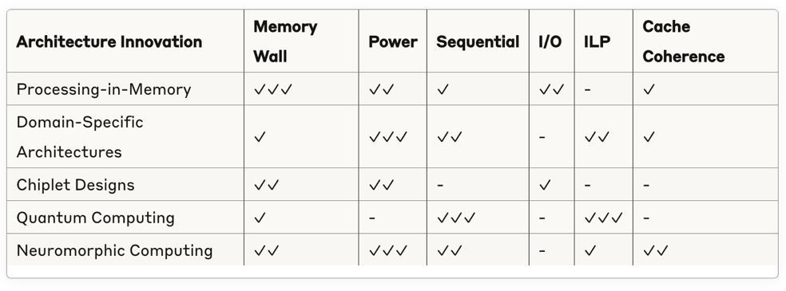
Innovations to address bottlenecks
Checkmarks indicate level of impact in addressing the bottleneck (more checkmarks = greater impact)

Slide 26
Non-von Neuman architectures
In-memory computation (IMC or PiM)

Slide 27
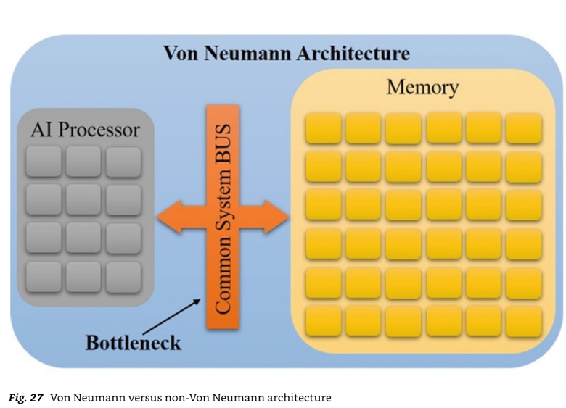
?
Mishra et al.

Slide 28
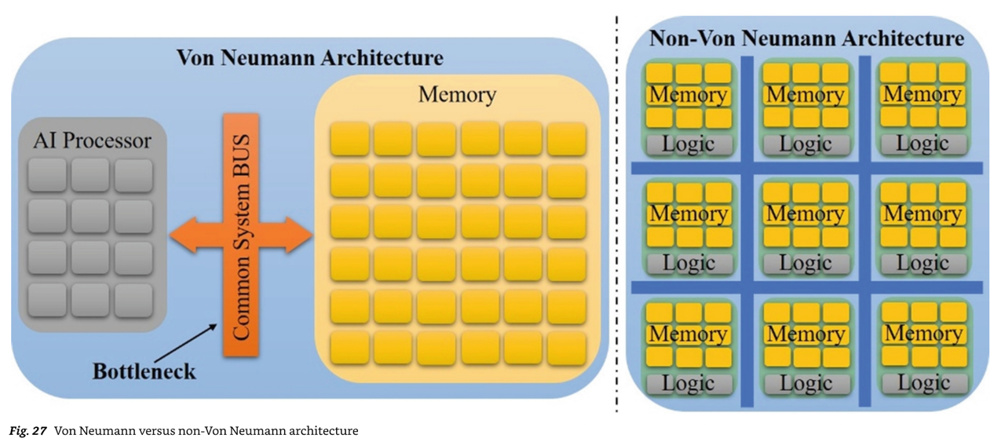
Fundamental problem: separation of memory and computation. Communication cost is fundamental, computer architectures cannot avoid it, but they can attempt to amortize it.
Mishra et al.

Slide 29
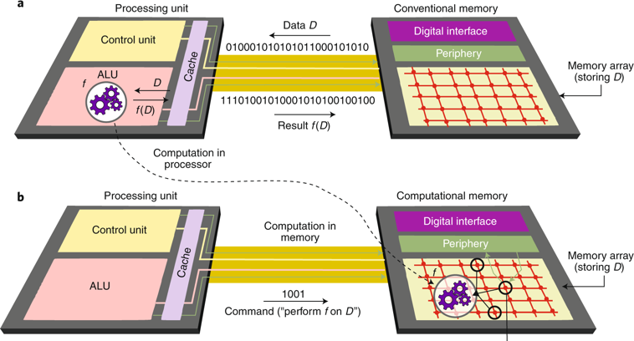
IMC: the basic idea is simple
Sebastian et al., Nature

Slide 30
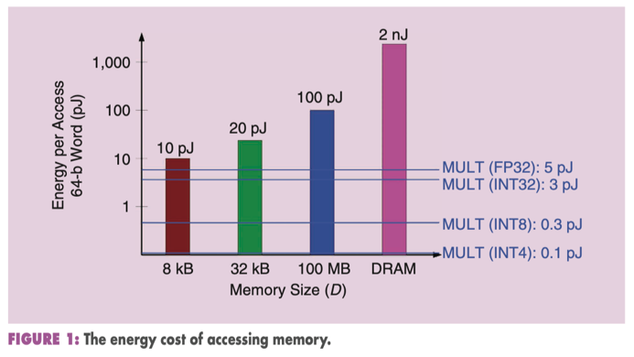
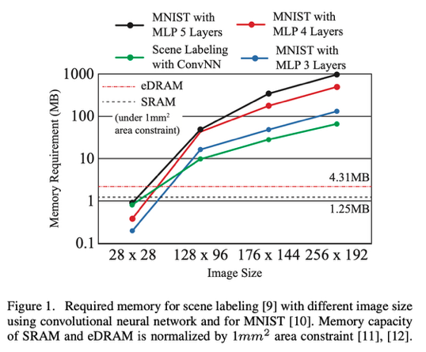
MULT for comparison
A comparison of the energy required to access one word of data (64 b) from different-sized memories in a 45-nm technology to the energy of multiplication operations (considering the lowered precision levels that are increasingly relevant for deep-learning inference computations.
Kim et al., Neurocube
Verma et al., In-Memory Computing, 2019

Slide 31
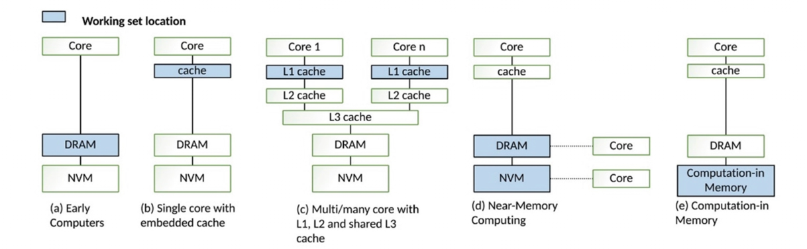
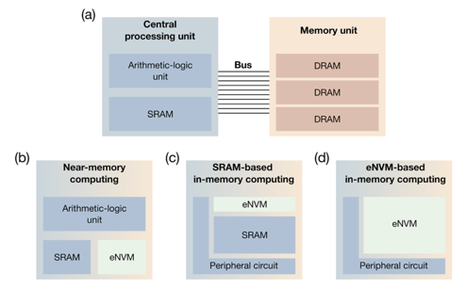
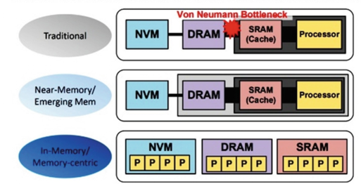
eNVM = embedded non-volatile memory
Mishra et al.
Mannocci et al.

Slide 32
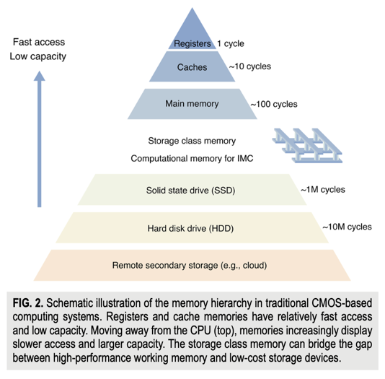
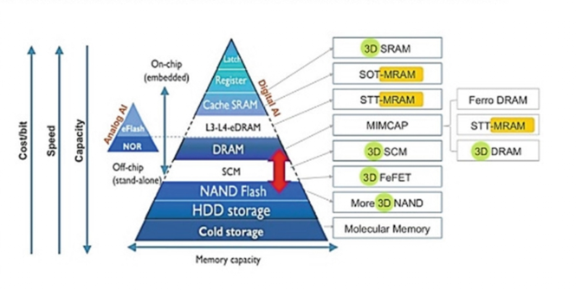
It’s all about trade-offs
Mishra et al.
Mannocci et al.

Slide 33
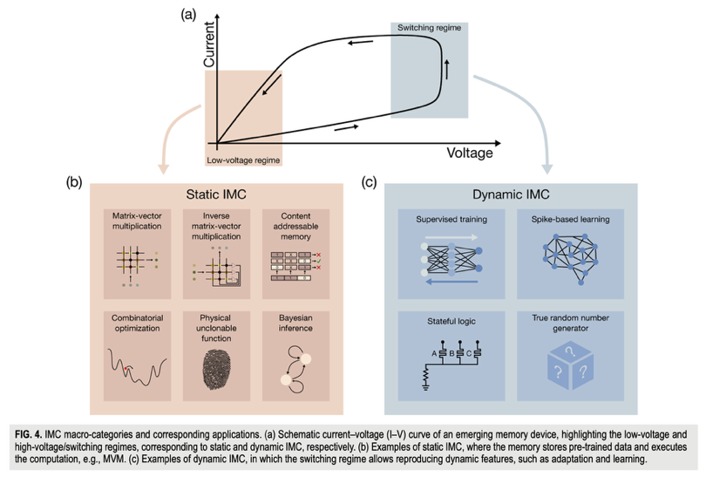
IMC macro-categories
Mannocci et al.

Slide 34
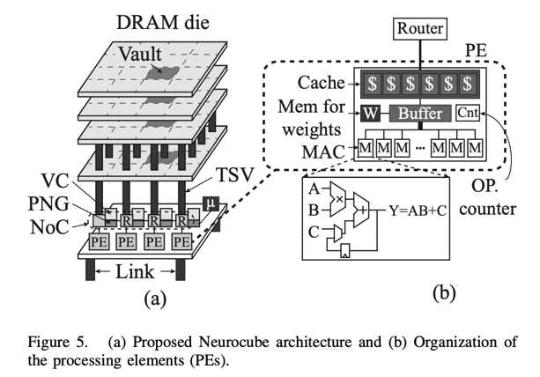
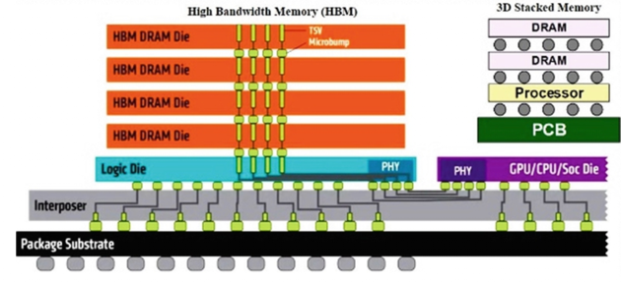
Stacked 3D chips
Mishra et al.
Kim et al., Neurocube

Slide 35
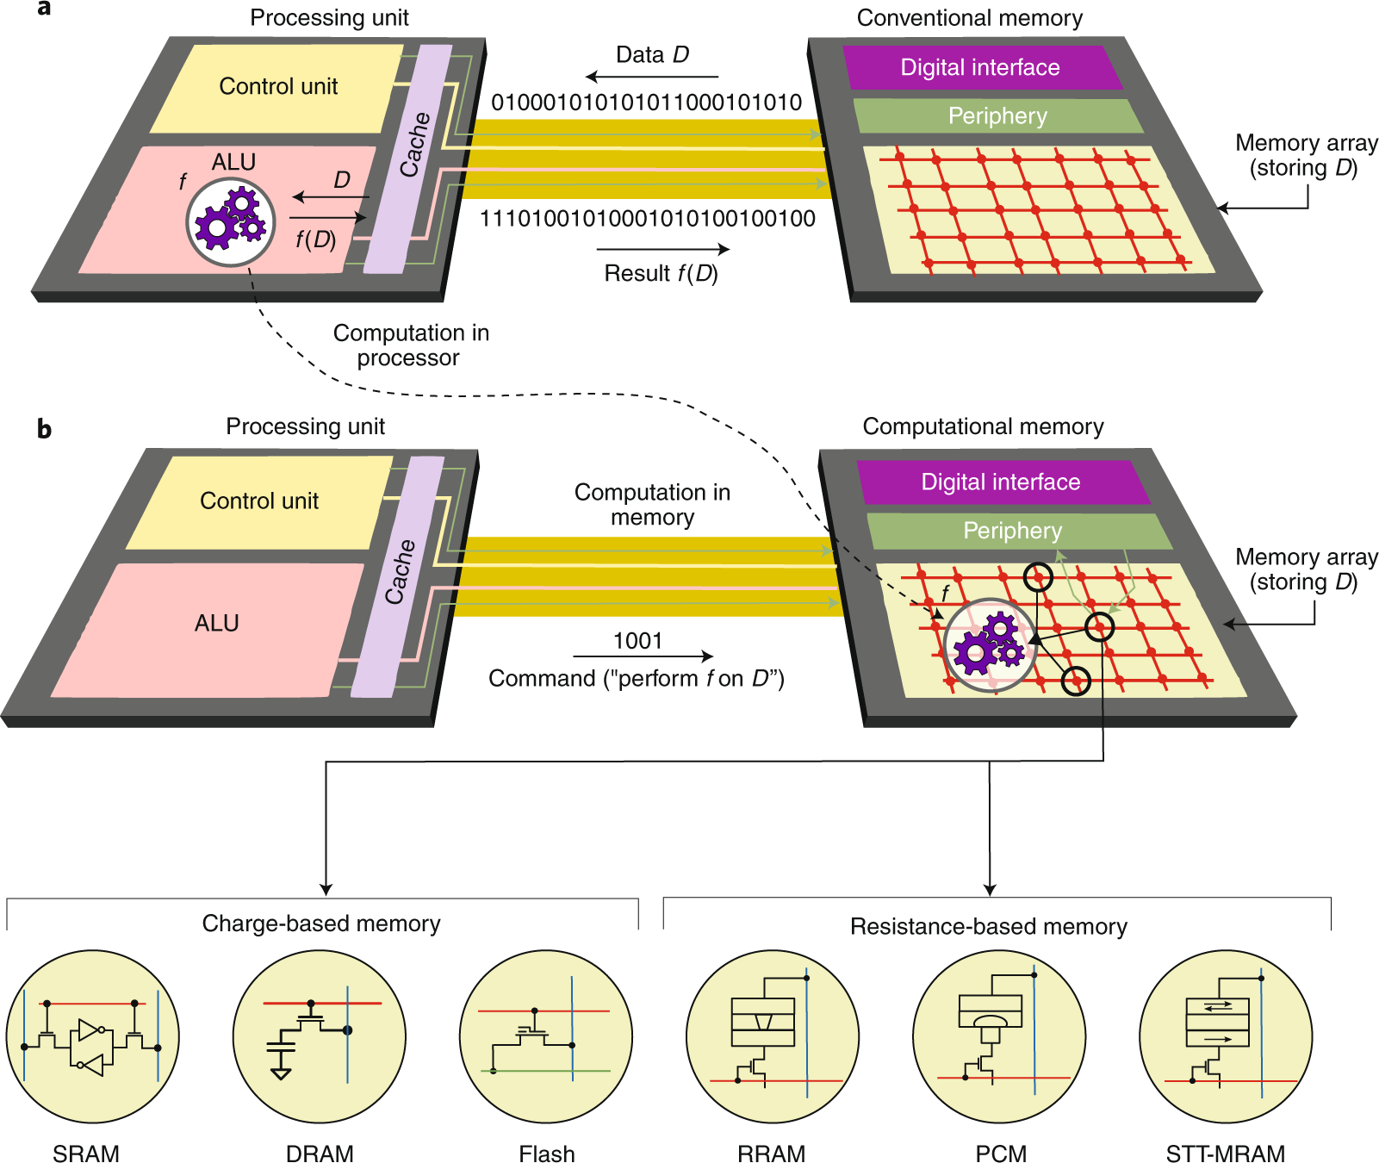
Sebastian et al., Nature

Slide 36
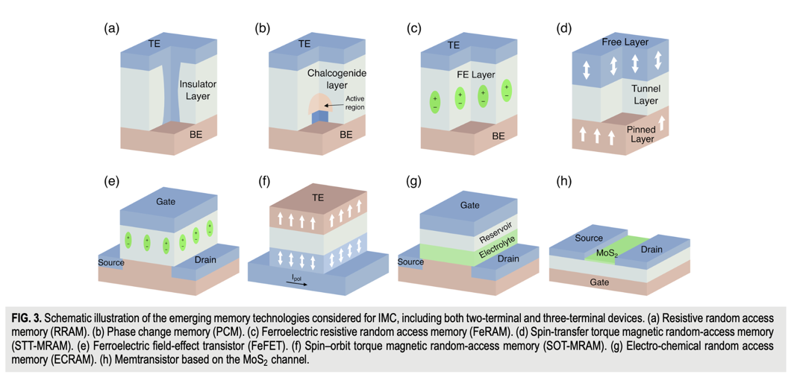
Emerging memory technologies
Mannocci et al.

Slide 37
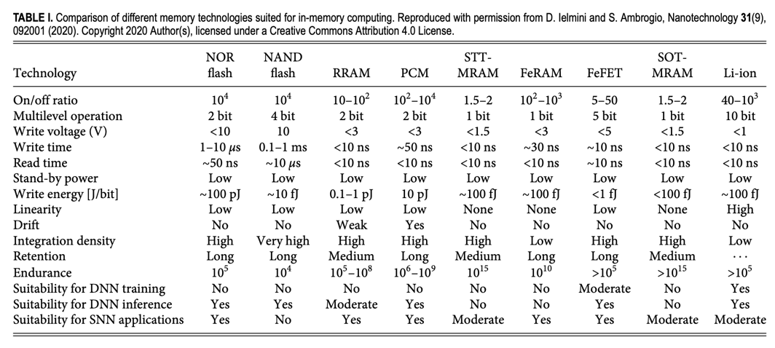
Emerging memory technologies
Mannocci et al.

Slide 38

Conventional vs Processing-in-Memory (PiM)
Mishra et al.

Slide 39


Matrix-vector multiplication (MCM)
Verma et al., In-Memory Computing, 2019

Slide 40


MVM (Matrix-Vector Multiplication) can be executed in a crosspoint memory array by universal circuit laws, such as Kirchhoff’s current law for summation and Ohm’s law for multiplication.
crosspoint array or
crossbar
Mannocci et al.

Slide 41


6-T SRAM
2 modes
SRAM mode:
One row accessed at a time via WL
IMC mode:
Multiple or all rows accessed
Each WL digital-to-analog converter (WLDAC) applies an analog voltage corresponding to an input-vector element.
Taking the bitlines (BL/BLb) as a differential signal, the stored data then have the effect of multiplying the input-vector element by +1/–1, and the currents from all bit cells in a column accumulate, generating an analog discharge of BL/BLb. This yields a multiply–accumulate (MAC) operation as required for MVM.
Verma et al., In-Memory Computing, 2019

Slide 42


IMC vs non-IMC comparison
IMC enables ~ 10x gains in each metric.
Verma et al., In-Memory Computing, 2019

Slide 43

How can we man a NN onto a crossbar?

Slide 44


How can we map a NN onto a crossbar?
DOI: 10.1109/ACCESS.2019.2944417
Parallel multiplication: When voltage is applied to the rows, the current flowing through each memristive junction is proportional to the product of the input voltage and the junction's conductance. This effectively performs multiplication at each intersection point simultaneously.
Current summation: The currents from all intersections in a column are naturally summed according to Kirchhoff's current law, effectively adding up all the partial products.
https://doi.org/10.3389/fnins.2021.690418

Slide 45

How can we map a NN onto a crossbar?
https://nanoconvergencejournal.springeropen.com/articles/10.1186/s40580-024-00463-0

Slide 46

Sneak paths
Sneak-paths in crossbars are unintended current pathways that occur in memory array architectures.
Solutions: diodes or 1T1R structures

Slide 47
Questions
What is the primary advantage of in-memory computing.
In a typical crossbar implementation of a neural network, where are the synaptic weights physically represented?
What are the benefits of spiking neural nets over analog neural nets?

